Slide 1
Chapter 1
Database Systems

Slide 2
Learning Objectives
In this chapter, you will learn:
The difference between data and information
What a database is, various types of databases, and why they are valuable assets for decision making
The importance of database design
How modern databases evolved from file systems
About flaws in file system data management
The main components of a database system
The main functions of a database management system (DBMS)

Slide 3
Data versus Information
Data
Information
Raw facts
Have not been processed to reveal their meaning to end users
Building blocks of information
Data management
Generation, storage, and retrieval of data
Produced by processing raw data to reveal its meaning
Requires context
Bedrock of knowledge
Should be accurate, relevant, and timely to enable good decision making

Slide 4
Introducing the Database
Shared, integrated computer structure that stores a collection of:
End-user data --- raw facts of interest to end users
Metadata: Data about data, through which end-user data are integrated and managed
Describe data characteristics, how the data is structured, and how different pieces of data relate to each other.
Database management system (DBMS) is a collection of programs that
manage the database structure
control access to the data stored in the database
without DBMS, the database would be difficult and unsafe to use

Slide 5
Role of the DBMS
Intermediary between the user and the database
Enables data to be shared
Presents the end user with an integrated view of the data
Receives and translates application requests into operations required to fulfill the requests
Hides database’s internal complexity from the application programs and users

Slide 6
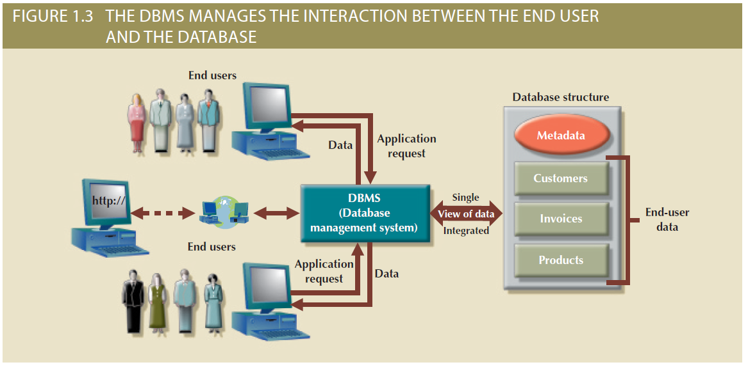
Figure 1.3 - The DBMS Manages the Interaction between the End User and the Database

Slide 7
Advantages of the DBMS
Better data integration and less data inconsistency
Data inconsistency: Different versions of the same data appear in different places
Increased end-user productivity
Improved:
Data sharing
Data security
Data access
Decision making
Data quality: A comprehensive approach to ensuring that data is accurate, valid and timely.

Slide 8
Types of Databases
The number of users they support: Single user, multiuser, enterprise
The location the data is located: Centralized, distributed, cloud
The type of data they store: general purpose, discipline specific
How they are used: operational, analytical
How structured their data is: structured databases, semi-structured databases, unstructured databases

Slide 9
Types of Databases
The number of users:
Single-user database: Supports one user at a time
Desktop database: Runs on PC
Multiuser database: Supports multiple users at the same time
Workgroup databases: Supports a small number of users or a specific department within an organization.
Enterprise database: Supports many users across many departments.

Slide 10
Types of Databases
Locations:
Centralized database: A database that supports data located at a single site;
Distributed database: A database that supports data distributed across different sites;
Cloud database: A database that is created and maintained using cloud data services that provide defined performance measures for the database, such as Amazon AWS.

Slide 11
Types of Databases
The type of data stored in the database:
General-purpose databases: Contains a wide variety of data used in multiple disciplines
Discipline-specific databases: Contains data focused on specific subject areas

Slide 12
Types of Databases
How they will be used and the time sensitivity of the information gathered from them:
Operational database: Designed to support a company’s day-to-day operations; also known as an online transaction processing (OLTP) database, transactional database, or production database.

Slide 13
Types of Databases
Analytical database: Stores historical data and business metrics used exclusively for tactical or strategic decision making. Two main components:
Data warehouse: Stores data in a format optimized for decision support
Online analytical processing (OLAP) front end
Tools for retrieving, processing, and modeling data from the data warehouse

Slide 14
Types of Databases
To reflect the degree to which the data is structured:
Unstructured data: exists in their original raw state.
Structured data: the results of formatting unstructured data to facilitate storage, use, and the generation of information.
Structure is applied based on the type of processing to be performed.
Semistructured data: has been processed to some extent.

Slide 15
Types of Databases
Semi-structured data contains some organizational structure, but does not follow a rigid table format. The storage and management of semi-structured data are addressed by a new generation of databases, including XML databases.
Extensible Markup Language (XML)
A text-based language used to represent data using tags and hierarchical structure.
A XML database supports the storage, management, and query of semi-structured XML data.

Slide 16
Database Design
The activities that focus on the design of the database structure that will be used to store and manage end-user data.
Well-designed database
Facilitates data management
Generates accurate and valuable information
Poorly designed database causes difficult-to-trace errors

Slide 17
Evolution of File System Data Processing
Manual File Systems
Accomplished through a system of file folders and filing cabinets
Computerized File Systems
Data processing (DP) specialist: Created a computer-based system that would track data and produce required reports
File System Redux: Modern End-User Productivity Tools
Includes spreadsheet programs such as Microsoft Excel

Slide 18
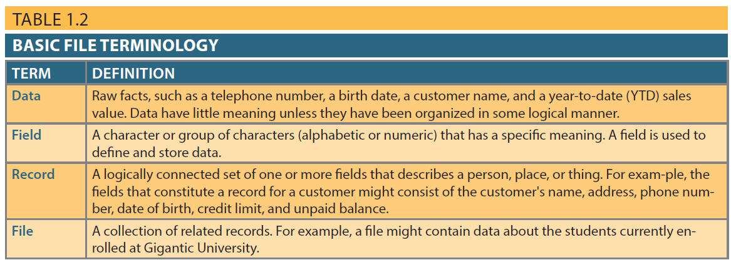
Table 1.2 - Basic File Terminology

Slide 19
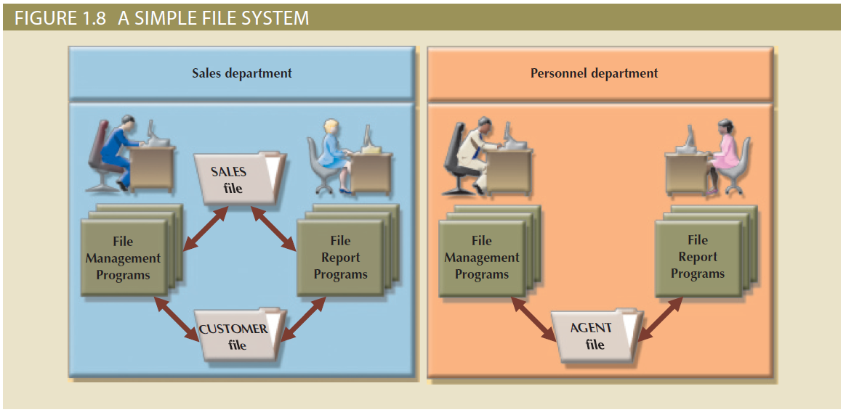
Figure 1.8 - A Simple File System

Slide 20
Problems with File System Data Processing
Lengthy development times
Difficulty of getting quick answers
Complex system administration
Lack of security and limited data sharing
Extensive programming

Slide 21
Extensive Programming
Making changes in the original file would require a program to:
Reads a record from the original file;
Transforms the original data to conform to the new structure’s storage requirements;
Writes the transformed data into the new file structure;
Repeats the preceding steps for each record in the original file.

Slide 22
Structural and Data Dependence
A file system is structural dependence.
Structural dependence: Access to a file is dependent on its structure
All file system programs are modified to conform to a new file structure
Structural independence: File structure is changed without affecting the application’s ability to access the data

Slide 23
Structural and Data Dependence
Data dependence
Data access changes when data storage characteristics change
Data independence
Data storage characteristics can be changed without affecting the program’s ability to access the data

Slide 24
Data Redundancy
Unnecessarily storing same data at different places
Islands of information: Scattered data locations
Increases the probability of having different versions of the same data

Slide 25
Data Redundancy Implications
Poor data security: Having multiple copies of data increases the chances of the data to be susceptible to unauthorized access.
Data inconsistency: when different and conflicting versions of the same data appear in different places.
Data entry errors: likely to occur when complex entries are made in different files.
Data integrity problems

Slide 26
Data Redundancy Implications
Data anomaly: Develops when not all of the required changes in the redundant data are made successfully

Slide 27
Types of Data Anomaly
Update Anomalies
Insertion Anomalies
Deletion Anomalies

Slide 28
Database Systems
Logically related data stored in a single logical data repository (to users), physically distributed among multiple storage facilities (disks, servers, locations)
DBMS eliminates most of file system’s problems
Current generation DBMS software:
Stores data structures, relationships between structures, and access paths
Defines, stores, and manages all access paths and components

Slide 29
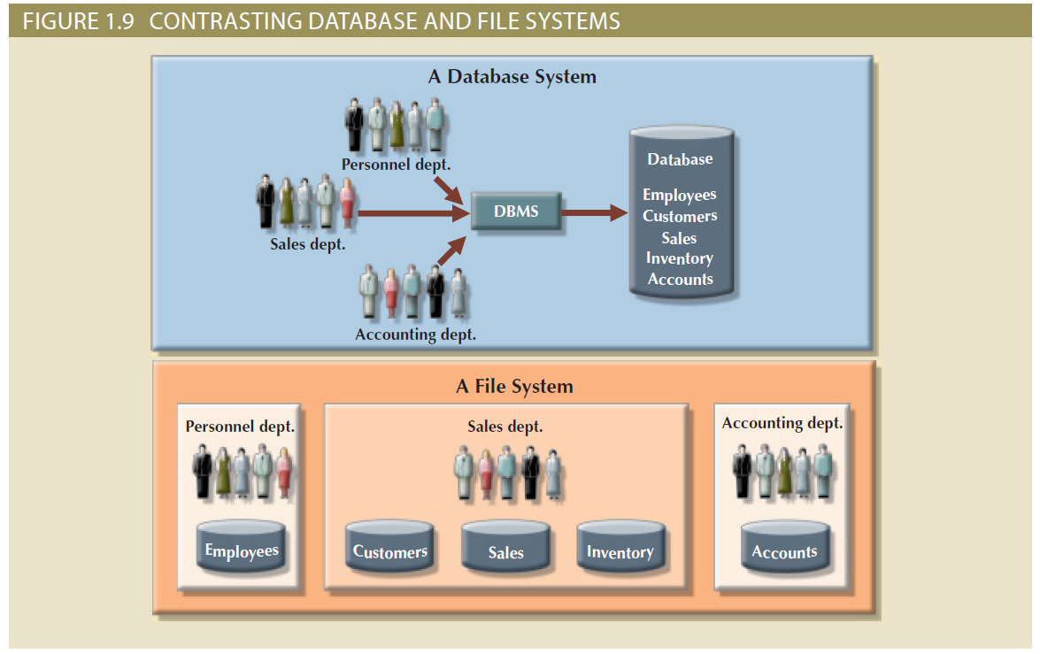
Figure 1.9 - Contrasting Database and File Systems

Slide 30
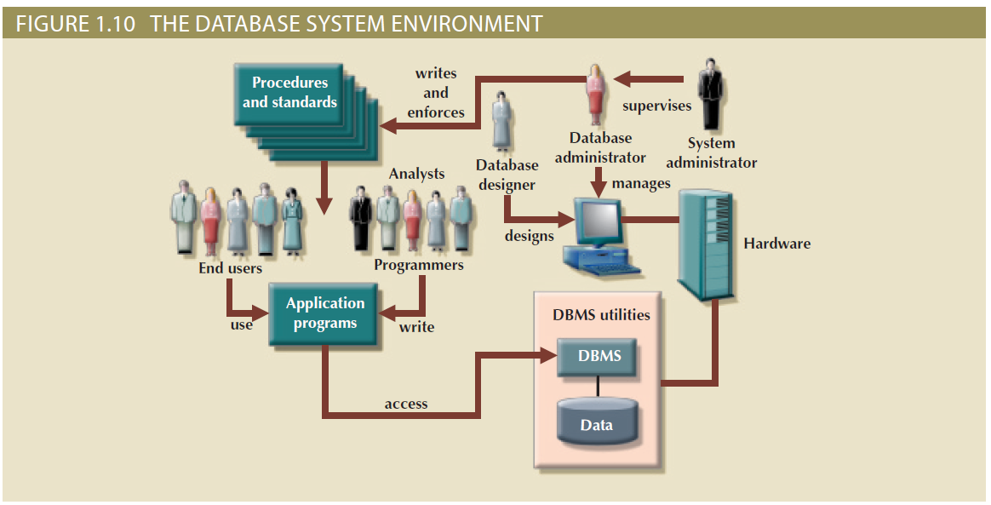
Figure 1.10 - The Database System Environment

Slide 31
DBMS Functions
Data dictionary management
Data dictionary: Stores definitions of the data elements and their relationships
Data storage management
Performance tuning: Ensures efficient performance of the database in terms of storage and access speed
Data transformation and presentation
Transforms entered data to conform to required data structures
Security management
Enforces user security and data privacy

Slide 32
DBMS Functions
Multiuser access control
Sophisticated algorithms ensure that multiple users can access the database concurrently without compromising its integrity
Backup and recovery management
Enables recovery of the database after a failure
Data integrity management
Minimizes redundancy and maximizes consistency

Slide 33
DBMS Functions
Database access languages and application programming interfaces
Query language: Lets the user specify what must be done without having to specify how
Structured Query Language (SQL): De facto query language and data access standard supported by the majority of DBMS vendors
Database communication interfaces
Accept end-user requests via multiple, different network environments

Slide 34
Disadvantages of Database Systems
Increased costs
Management complexity
Maintaining currency
Vendor dependence
Frequent upgrade/replacement cycles

Slide 35
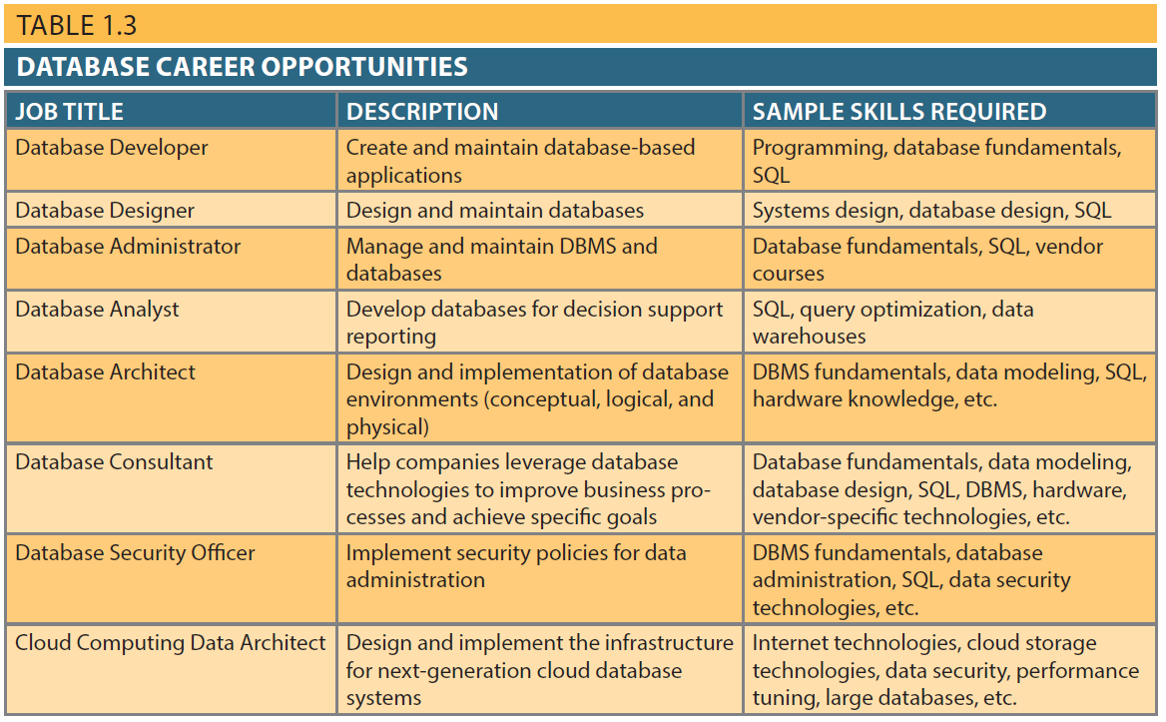
Table 1.3 - Database Career Opportunities
31

Slide 36
Real-World Example: Amazon
Amazon uses massive databases to manage products, customers, orders, and deliveries.
Operational databases track real-time transactions such as purchases and payments.
Analytical databases analyze customer behavior, recommendations, and sales trends.
A DBMS ensures millions of users can shop simultaneously without data conflicts.

Slide 37
Real-World Example: Banks
Banks use databases to store customer accounts, balances, and transaction histories.
DBMSs guarantee accuracy and consistency when money is transferred.
Concurrency control ensures multiple ATMs can access the same account safely.
Security features protect sensitive financial data from unauthorized access.

Slide 38
Real-World Example: Hospitals
Hospitals store patient records, lab results, and billing data in databases.
Databases allow doctors, nurses, and administrators to share accurate information.
Data integrity is critical—incorrect data can lead to medical errors.
Access controls ensure only authorized personnel view sensitive patient data.

