Slide 1
Chapter 3
The Relational Database Model

Slide 2
Learning Objectives
In this chapter, you will learn:
  That the relational database model offers a logical view of data
  About the relational model’s basic component: relations
  That relations are logical constructs composed of rows (tuples) and columns (attributes)
  That relations are implemented as tables in a relational DBMS

Slide 3
Learning Objectives
In this chapter, you will learn:
  About relational database operators, the data dictionary, and the system catalog
  How data redundancy is handled in the relational database model
  Why indexing is important

Slide 4
A Logical View of Data
Relational database model enables logical representation of the data and its relationships
Logical simplicity yields simple and effective database design methodologies
Facilitated by the creation of data relationships based on a logical construct called a relation

Slide 5
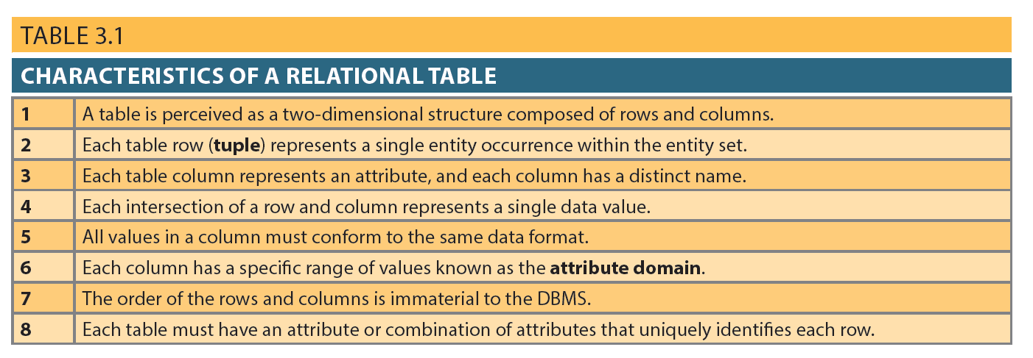
Table 3.1 - Characteristics of a Relational Table

Slide 6
Keys
Consist of one or more attributes that determine other attributes
Used to:
  Ensure that each row in a table is uniquely identifiable
  Establish relationships among tables and to ensure the integrity of the data
Primary key (PK): Attribute or combination of attributes that uniquely identifies any given row

Slide 7
Determination
State in which knowing the value of one attribute makes it possible to determine the value of another
Basis for establishing the role of a key
Based on the relationships among the attributes

Slide 8
Dependencies
Functional dependence: Value of one or more attributes determines the value of one or more other attributes
  Determinant: Attribute whose value determines another
  Dependent: Attribute whose value is determined by the other attribute
Full functional dependence: Entire collection of attributes in the determinant is necessary for the relationship

Slide 9
Types of Keys
Composite key: Key that is composed of more than one attribute
Key attribute: Attribute that is a part of a key
Entity integrity: Condition in which each row in the table has its own unique identity
  All of the values in the primary key must be unique
  No key attribute in the primary key can contain a null

Slide 10
Types of Keys
    Null: Absence of any data value that could represent:
      An unknown attribute value
      A known, but missing, attribute value
      A inapplicable condition
    Referential integrity: Every reference to an entity instance by another entity instance is valid
    Secondary key: Key used strictly for data retrieval purposes

Slide 11
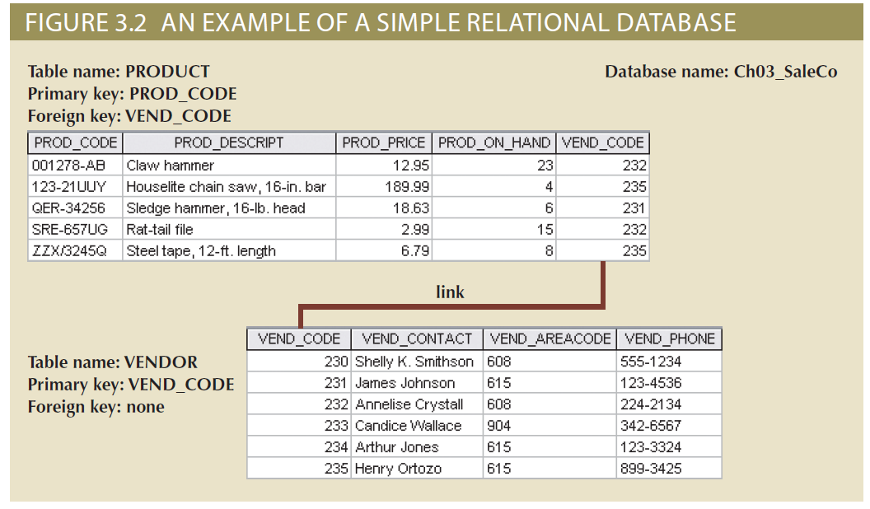
Figure 3.2 - An Example of a Simple Relational Database

Slide 12
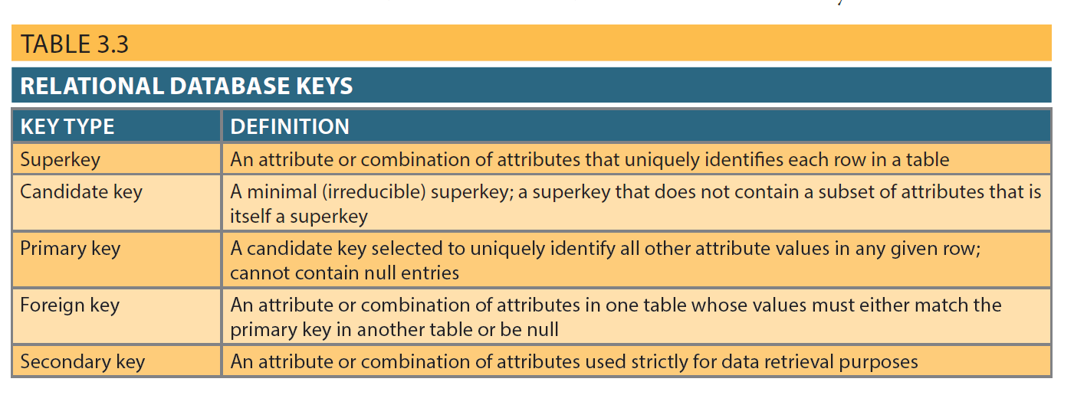
Table 3.3 - Relational Database Keys

Slide 13
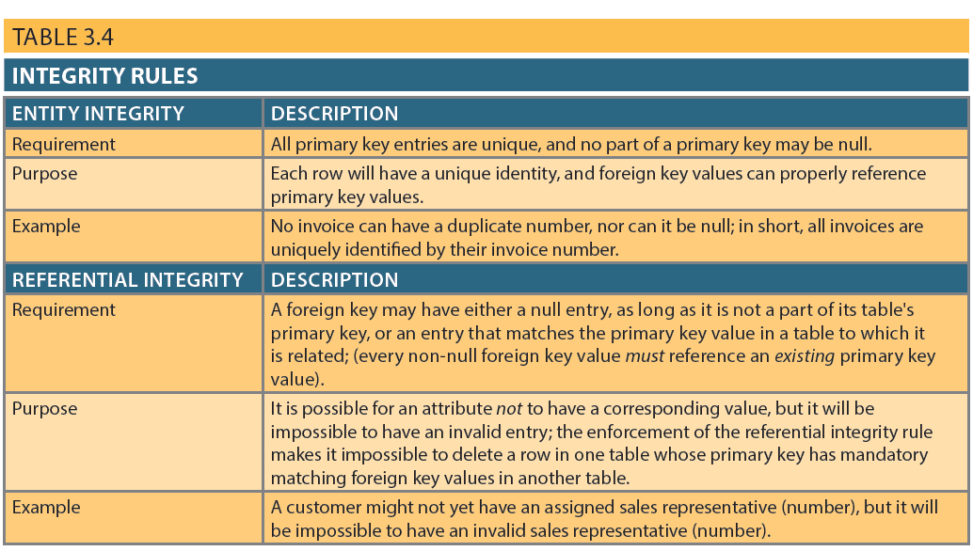
Integrity Rules

Slide 14
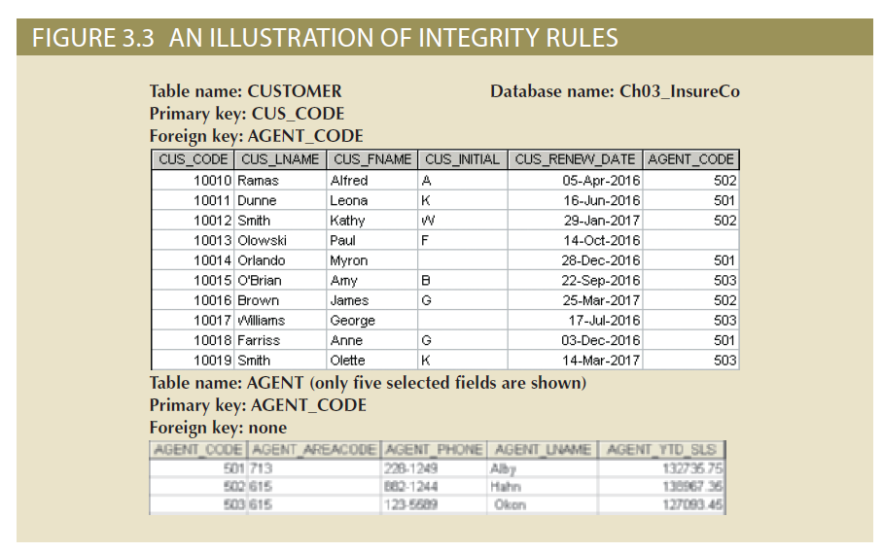
Figure 3.3 - An Illustration of Integrity Rules

Slide 15
Ways to Handle Nulls
Flags: Special codes used to indicate the absence of some value
NOT NULL constraint - Placed on a column to ensure that every row in the table has a value for that column
UNIQUE constraint - Restriction placed on a column to ensure that no duplicate values exist for that column

Slide 16
Relational Algebra
Theoretical way of manipulating table contents using relational operators
Relvar: Variable that holds a relation
  Heading contains the names of the attributes and the body contains the relation
Relational operators have the property of closure
  Closure: Use of relational algebra operators on existing relations produces new relations

Slide 17
Relational Set Operators
Select (Restrict)
  Unary operator that yields a horizontal subset of a table
Project
  Unary operator that yields a vertical subset of a table
Union
  Combines all rows from two tables, excluding duplicate rows
  Union-compatible: Tables share the same number of columns, and their corresponding columns share compatible domains
Intersect
  Yields only the rows that appear in both tables
  Tables must be union-compatible to yield valid results

Slide 18
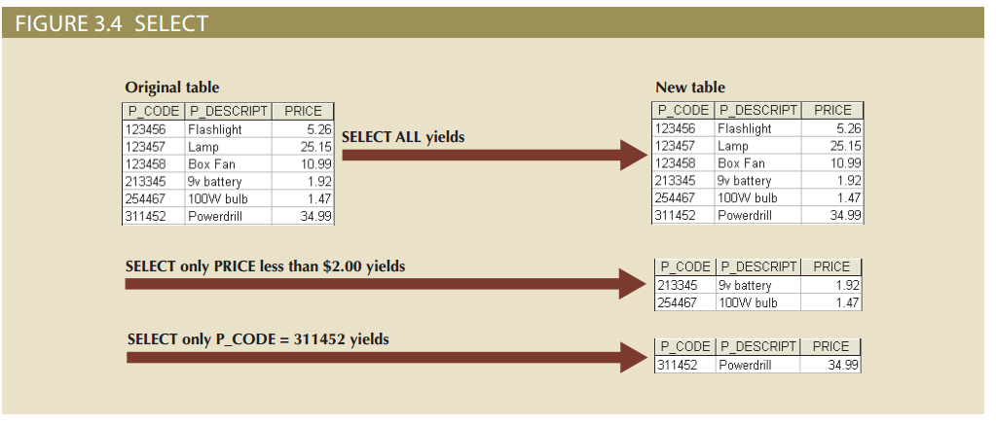
Figure 3.4 - Select

Slide 19
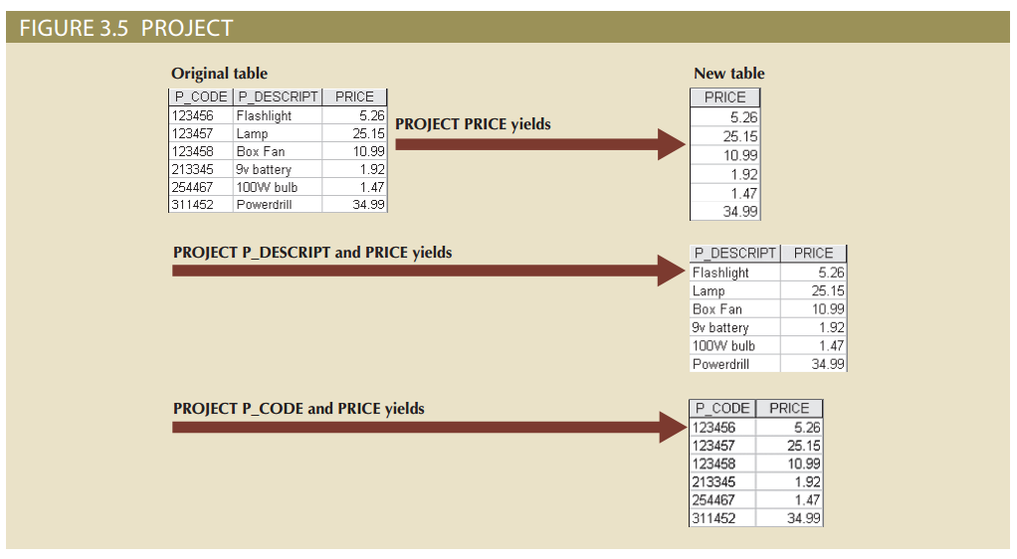
Figure 3.5 - Project

Slide 20
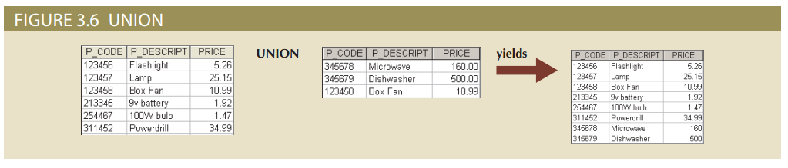
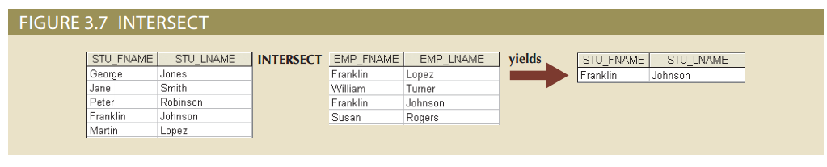
Figure 3.6 - Union and Figure 3.7 - Intersect

Slide 21
Relational Set Operators
Difference
  Yields all rows in one table that are not found in the other table
  Tables must be union-compatible to yield valid results
Product
  Yields all possible pairs of rows from two tables

Slide 22
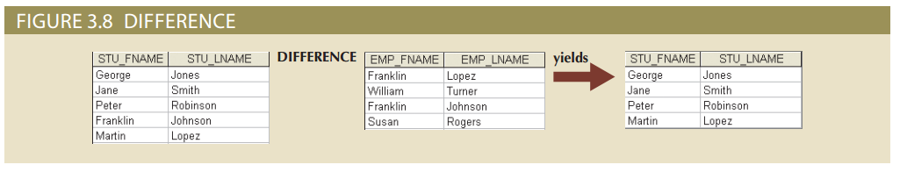
Figure 3.8 – Difference

Slide 23
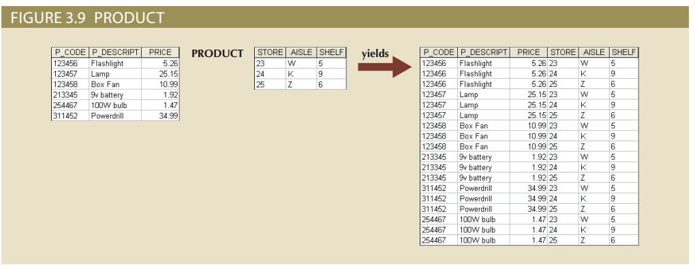
Figure 3.9 - Product

Slide 24
Relational Set Operators
Join
  Allows information to be intelligently combined from two or more tables
Divide
  Uses one 2-column table as the dividend and one single-column table as the divisor
  Output is a single column that contains all values from the second column of the dividend that are associated with every row in the divisor

Slide 25
Types of Joins
Natural join: Links tables by selecting only the rows with common values in their common attributes
  Join columns: Common columns
Equijoin: Links tables on the basis of an equality condition that compares specified columns of each table
Theta join: Extension of natural join, denoted by adding a theta subscript after the JOIN symbol

Slide 26
Types of Joins
Inner join: Only returns matched records from the tables that are being joined
Outer join: Matched pairs are retained and unmatched values in the other table are left null
  Left outer join: Yields all of the rows in the first table, including those that do not have a matching value in the second table
  Right outer join: Yields all of the rows in the second table, including those that do not have matching values in the first table

Slide 27
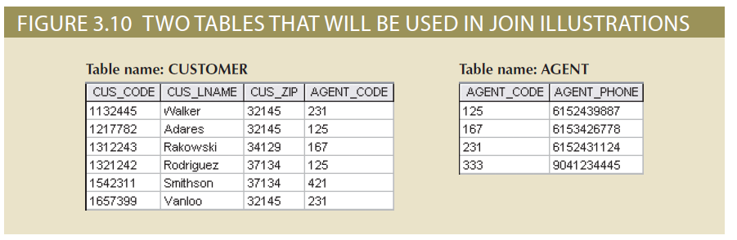
Figure 3.10 - Two Tables That Will Be Used in JOIN Illustrations

Slide 28
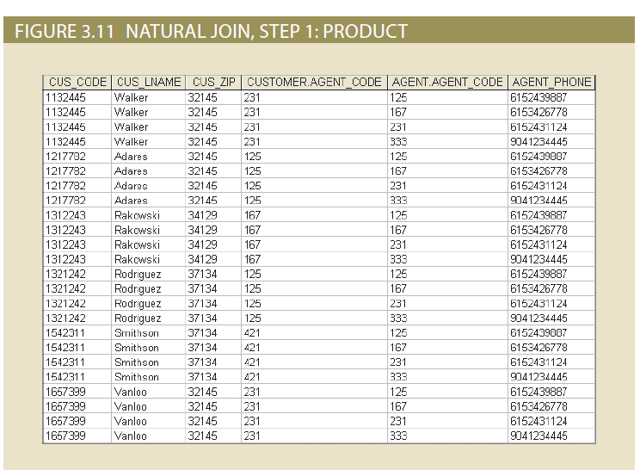
Natural Join: product->select->project

Slide 29
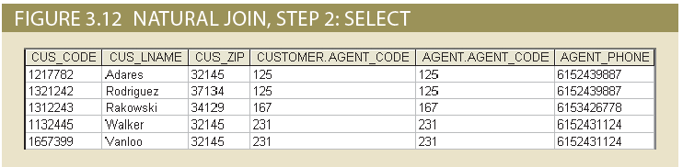
Step1: Select rows with equal attribute values

Slide 30
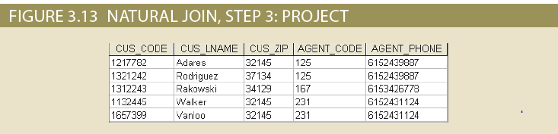
Step3: Project to yield only one single copy of each attribute

Slide 31
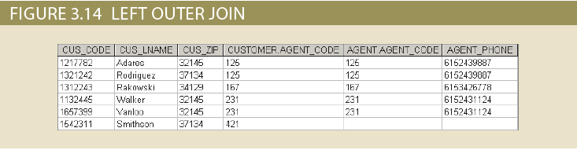
Left outer join: yield all the rows in the left table, including those that do not have a matching value in the right table

Slide 32
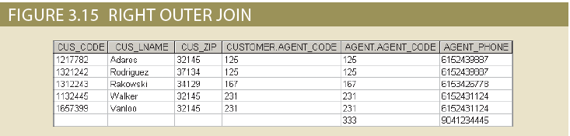
Right outer join: yield all of the rows in the right table, including those that do not have matching values in the left table

Slide 33
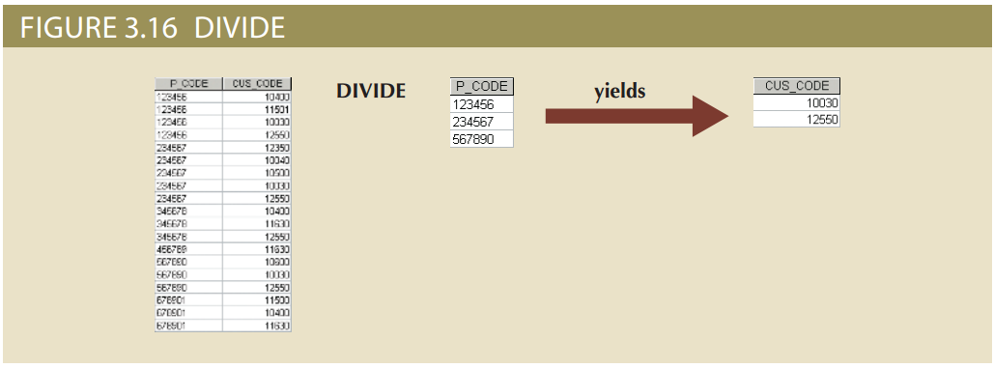
Figure 3.16 – Divide: return tuples of table 1 associated with all tuples of table 2

Slide 34
Data Dictionary and the System Catalog
Data dictionary: Description of all tables in the database created by the user and designer
System catalog: System data dictionary that describes all objects within the database
Homonyms and synonyms must be avoided to lessen confusion
    Homonym: Same name is used to label different attributes
    Synonym: Different names are used to describe the same attribute

Slide 35
Relationships within the Relational Database
1:M relationship - Norm for relational databases
1:1 relationship - One entity can be related to only one other entity and vice versa
Many-to-many (M:N) relationship - Implemented by creating a new entity in 1:M relationships with the original entities
  Composite entity (Bridge or associative entity): Helps avoid problems inherent to M:N relationships, includes the primary keys of tables to be linked

Slide 36
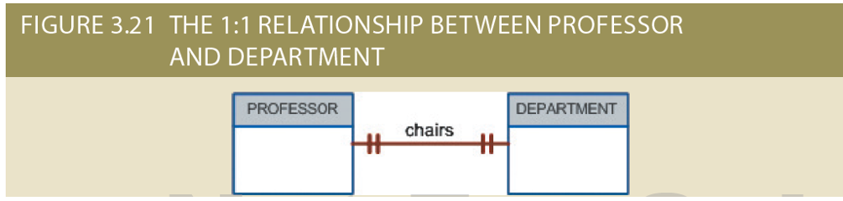
Figure 3.21 - The 1:1 Relationship between PROFESSOR and DEPARTMENT

Slide 37
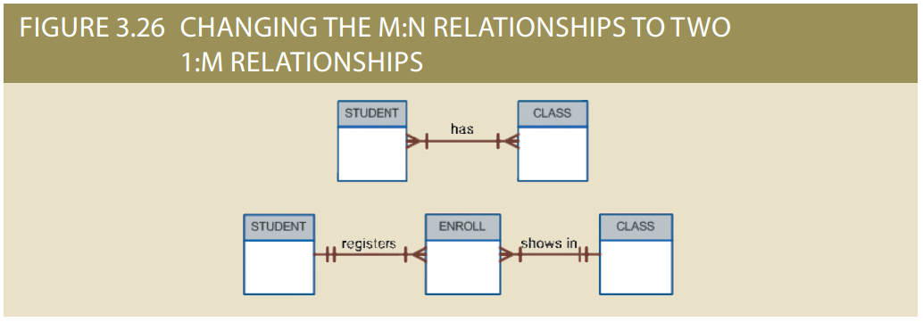
Figure 3.26 - Changing the M:N Relationship to Two 1:M Relationships

Slide 38
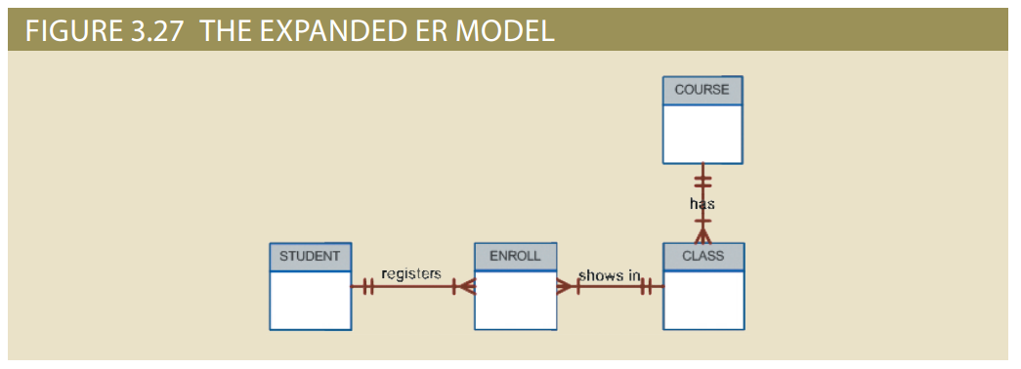
Figure 3.27 - The Expanded ER Model

Slide 39
Data Redundancy Revisited
Relational database facilitates control of data redundancies through use of foreign keys
To be controlled except the following circumstances
  Data redundancy must be increased to make the database serve crucial information purposes, i.e. prevent data loss in the case of data corruption.
  Exists to preserve the historical accuracy of the data

Slide 40
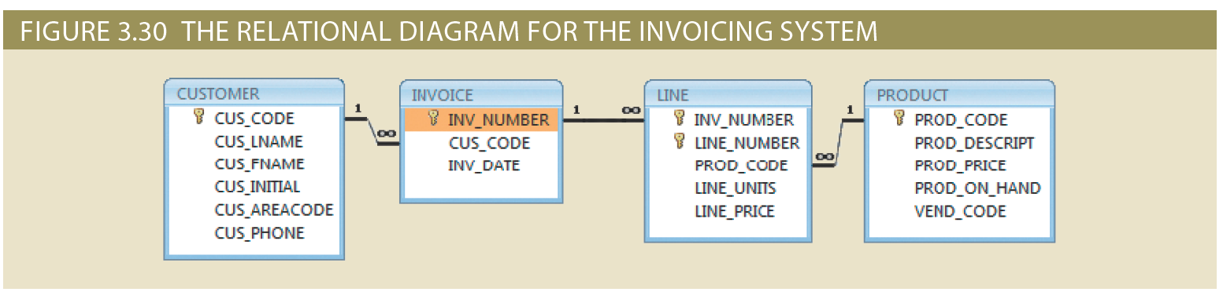
Figure 3.30 - The Relational Diagram for the Invoicing System

Slide 41
Indexes
Orderly arrangement to logically access rows in a table
Index key: Index’s reference point that leads to data location identified by the key
Unique index: Index key can have only one pointer value associated with it
Each index is associated with only one table

Slide 42
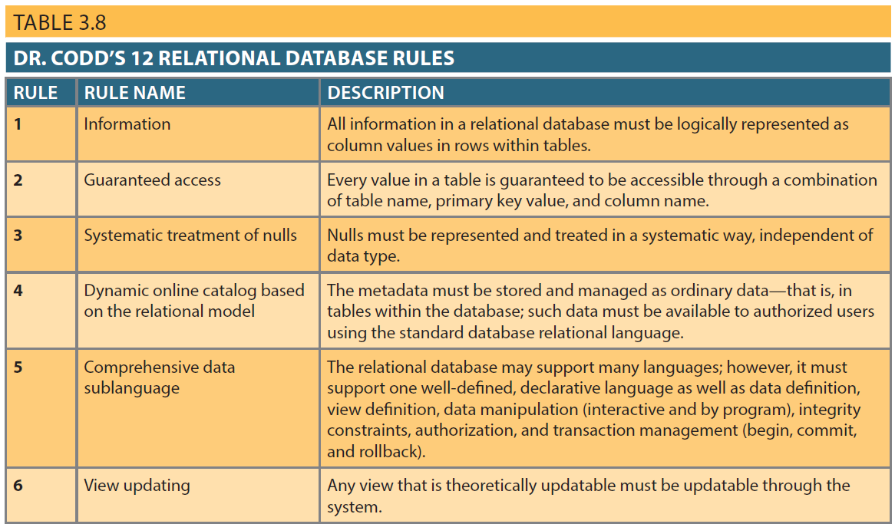
Table 3.8 – Dr. Codd’s 12 Relational Database Rules

Slide 43
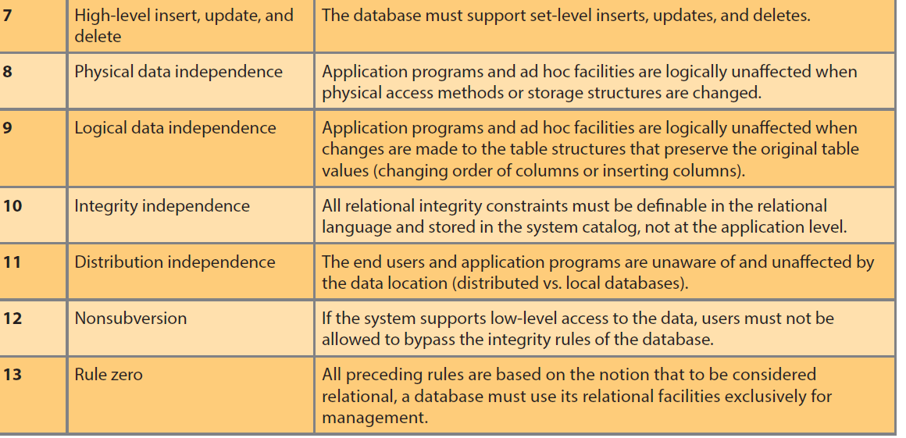
Table 3.8 – Dr. Codd’s 12 Relational Database Rules

