Slide 1
Chapter 6
Normalization of Database Tables

Slide 2
Learning Objectives
In this chapter, you will learn:
  What normalization is and what role it plays in the database design process
  About the normal forms 1NF, 2NF, 3NF, BCNF,
  and 4NF
  How normal forms can be transformed from lower normal forms to higher normal forms
  That normalization and ER modeling are used concurrently to produce a good database design
  That some situations require denormalization to generate information efficiently

Slide 3
Normalization
Evaluating and correcting table structures to minimize data redundancies
Reduces data anomalies
Assigns attributes to tables based on determination
Normal forms
  First normal form (1NF)
  Second normal form (2NF)
  Third normal form (3NF)

Slide 4
Normalization
Structural point of view of normal forms
  Higher normal forms are better than lower normal forms
Properly designed 3NF structures meet the requirement of fourth normal form (4NF)
Denormalization: Produces a lower normal form
  Results in increased performance and greater data redundancy

Slide 5
Need for Normalization
Used while designing a new database structure
  Analyzes the relationship among the attributes within each entity
  Determines if the structure can be improved
Improves the existing data structure and creates an appropriate database design

Slide 6
Normalization Process
Objective is to ensure that each table conforms to the concept of well-formed relations
  Each table represents a single subject
  No data item will be unnecessarily stored in more than one table
  All nonprime attributes in a table are dependent on the primary key
  Each table is void of insertion, update, and deletion anomalies

Slide 7
Normalization Process
Ensures that all tables are in at least 3NF
Higher forms are not likely to be encountered in business environment
Works one relation at a time
Starts by:
  Identifying the dependencies of a relation (table)
  Progressively breaking the relation into new set of relations

Slide 8
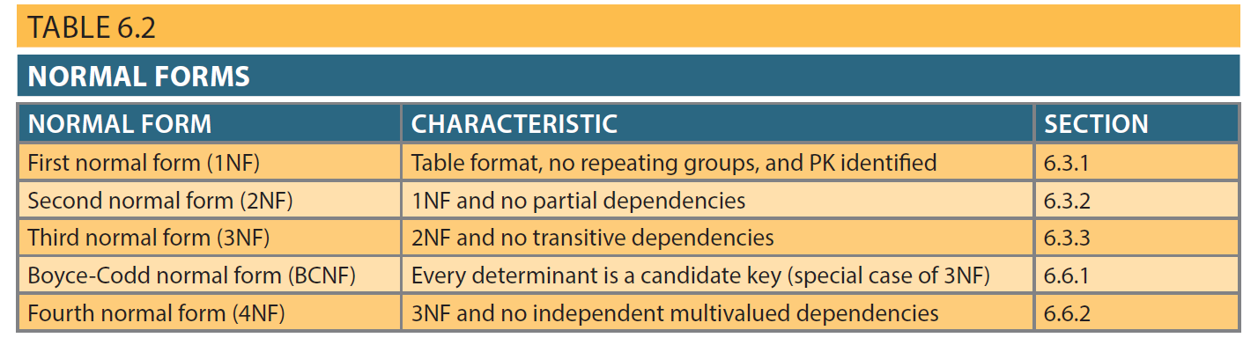
Table 6.2 - Normal Forms

Slide 9
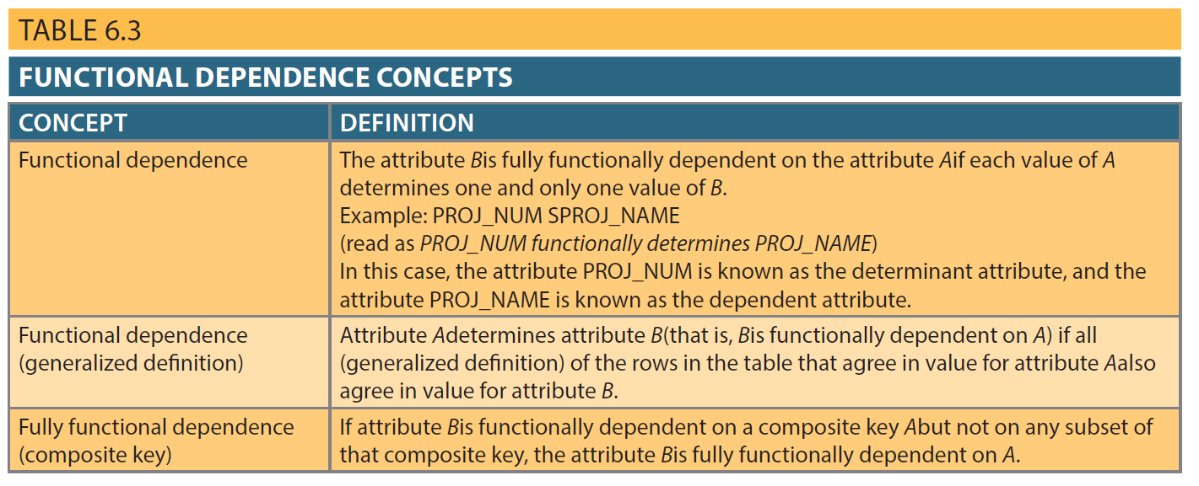
Table 6.3 - Functional Dependence Concepts

Slide 10
Types of Functional Dependencies
Partial dependency: Functional dependence in which the determinant is only part of the primary key
  Assumption - One candidate key
  Straight forward
  Easy to identify
Transitive dependency: An attribute functionally depends on another nonkey attribute

Slide 11
Conversion to First Normal Form
Repeating group: Group of multiple entries of same type can exist for any single key attribute occurrence
  Existence proves the presence of data redundancies
Enable reducing data redundancies
Steps
  Eliminate the repeating groups
  Identify the primary key
  Identify all dependencies

Slide 12
Conversion to First Normal Form
Dependency diagram: Depicts all dependencies found within given table structure
  Helps to get an overview of all relationships among table’s attributes
  Makes it less likely that an important dependency will be overlooked

Slide 13
Conversion to First Normal Form
1NF describes tabular format in which:
  All key attributes are defined
  There are no repeating groups in the table
  All attributes are dependent on the primary key
All relational tables satisfy 1NF requirements
Some tables contain partial dependencies
  Subject to data redundancies and various anomalies

Slide 14
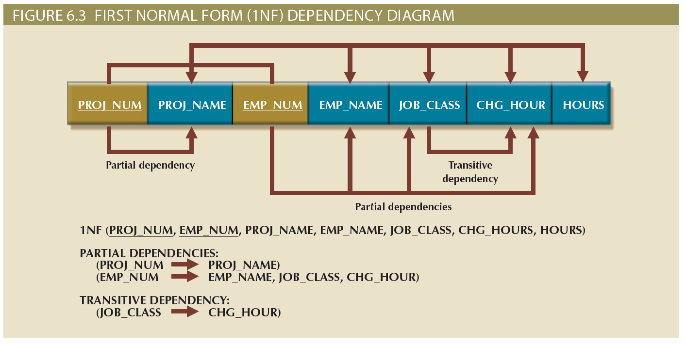
Figure 6.3 - First Normal Form (1NF) Dependency Diagram

Slide 15
Conversion to Second Normal Form
Steps
  Make new tables to eliminate partial dependencies
  Reassign corresponding dependent attributes
Table is in 2NF when it:
  Is in 1NF
  Includes no partial dependencies

Slide 16
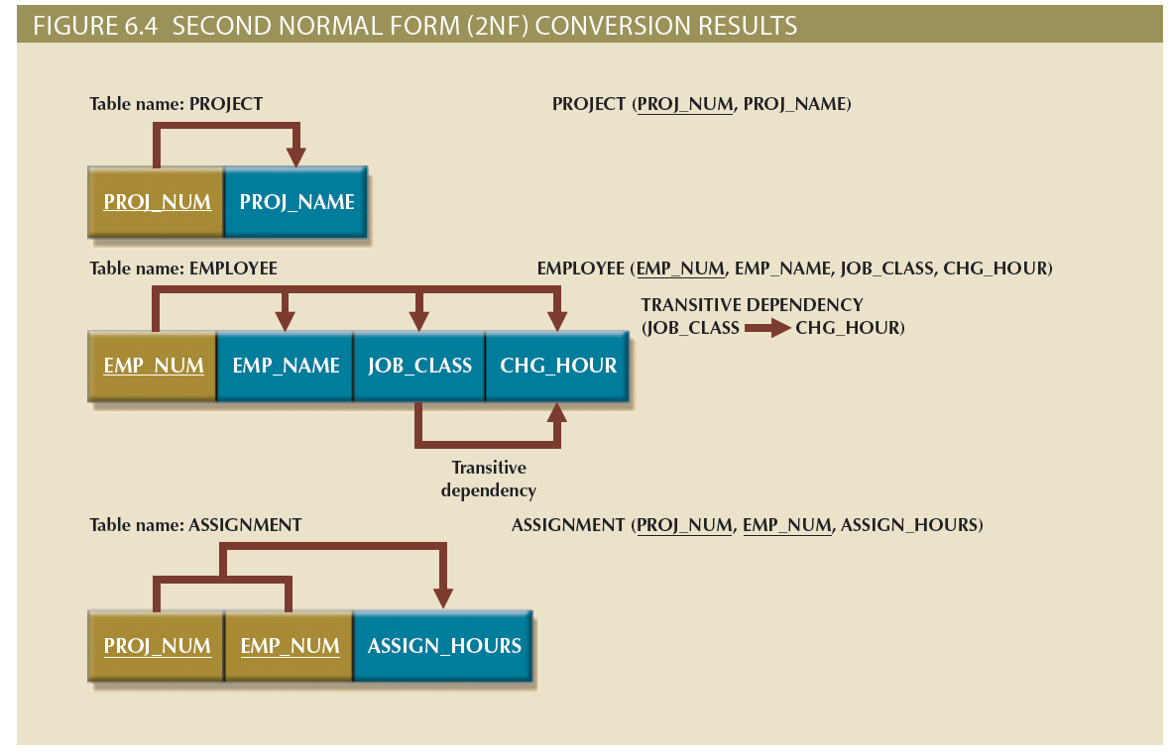
Figure 6.4 - Second Normal Form (2NF) Conversion Results

Slide 17
Conversion to Third Normal Form
Steps
  Make new tables to eliminate transitive dependencies
    Determinant: Any attribute whose value determines other values within a row
  Reassign corresponding dependent attributes
Table is in 3NF when it:
  Is in 2NF
  Contains no transitive dependencies

Slide 18
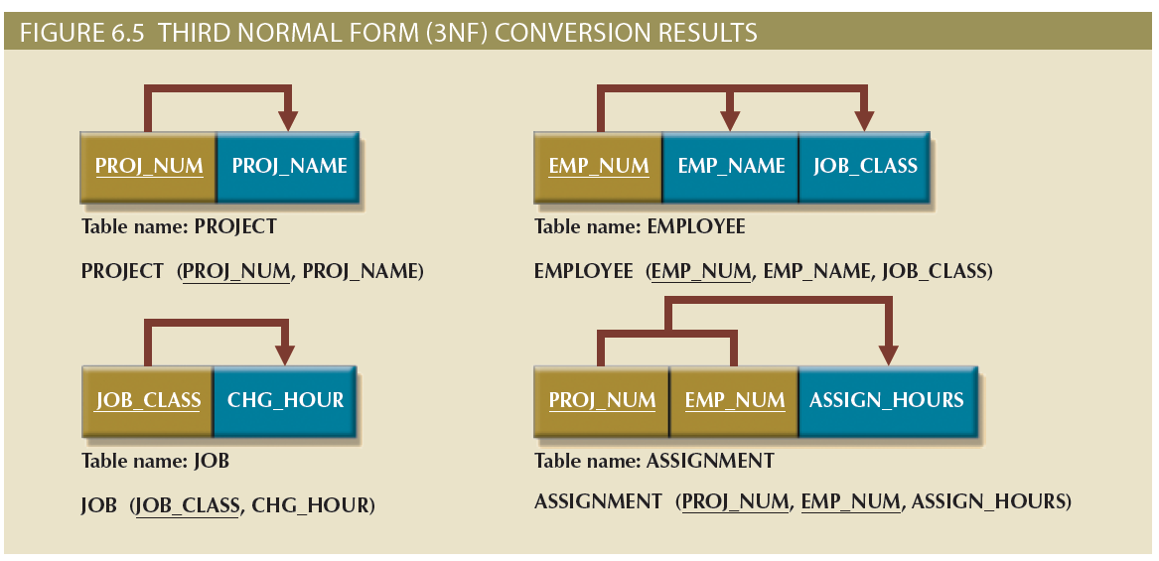
Figure 6.5 - Third Normal Form (3NF) Conversion Results

Slide 19
Improving the Design
Evaluate PK assignments and naming conventions
Refine attribute atomicity
  Atomic attribute: Cannot be further subdivided
  Atomicity: Characteristic of an atomic attribute
Identify new attributes and new relationships
Refine primary keys as required for data granularity
  Granularity: Level of detail represented by the values stored in a table’s row
Maintain historical accuracy and evaluate using derived attributes

Slide 20
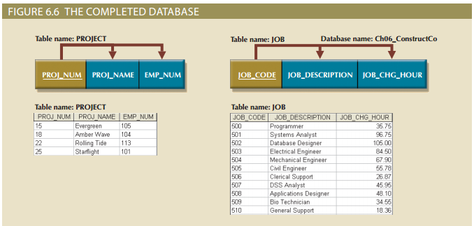
Figure 6.6 - The Completed Database

Slide 21
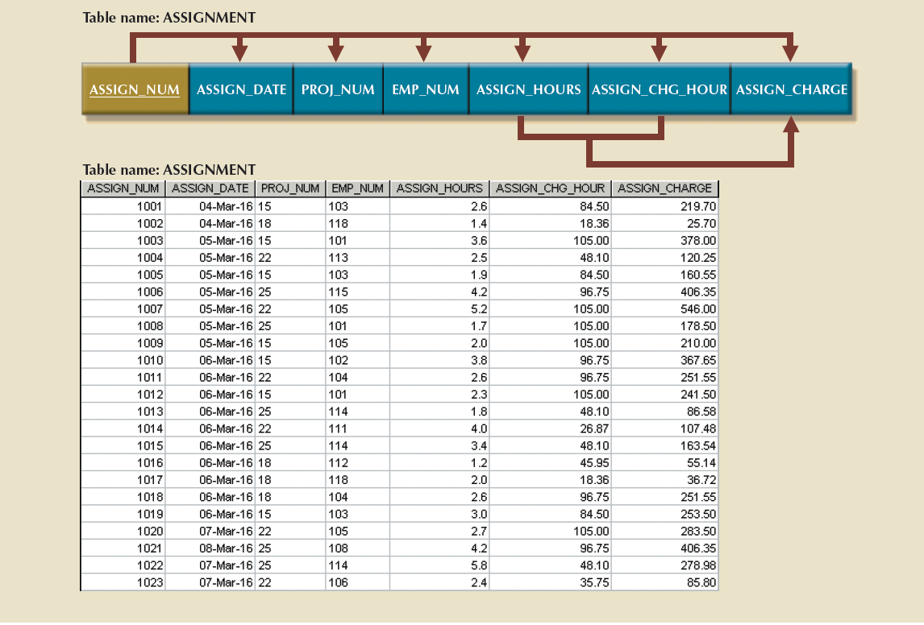
Figure 6.6 - The Completed Database (cont’d.)

Slide 22
Surrogate Key Considerations
Used by designers when the primary key is considered to be unsuitable
System-defined attribute
Created an managed via the DBMS
Have a numeric value which is automatically incremented for each new row

Slide 23
The Boyce-Codd Normal Form (BCNF)
Every determinant in the table should be a candidate key
  Candidate key - Same characteristics as primary key but not chosen to be the primary key
Equivalent to 3NF when the table contains only one candidate key
Violated only when the table contains more than one candidate key
Considered to be a special case of 3NF

Slide 24
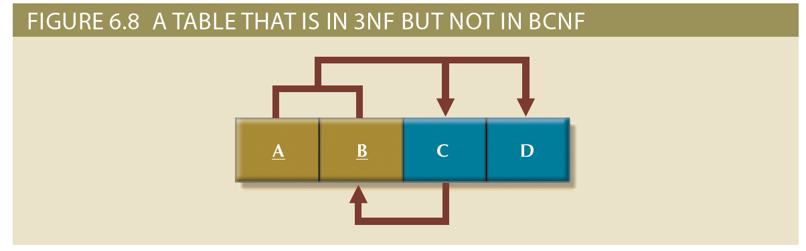
Figure 6.8 - A Table That is in 3NF and not in BCNF

Slide 25
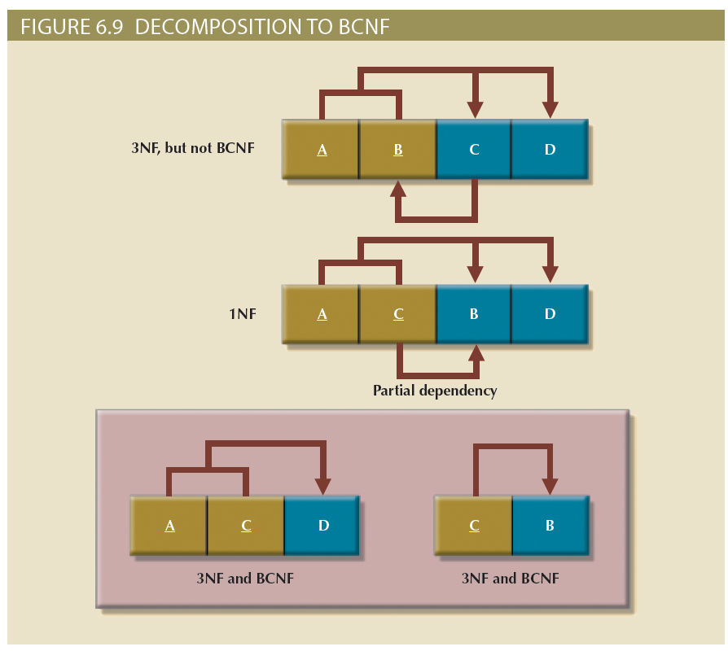
Figure 6.9 – Decomposition to BCNF

Slide 26
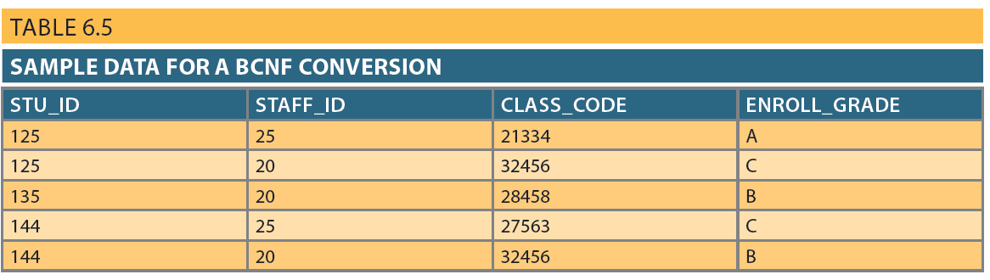
Table 6.5 - Sample Data for a BCNF Conversion

Slide 27
Fourth Normal Form (4NF)
Table is in 4NF when it:
  Is in 3NF
  Has no multivalued dependencies
Rules
  All attributes must be dependent on the primary key, but they must be independent of each other
  No row may contain two or more multivalued facts about an entity

Slide 28
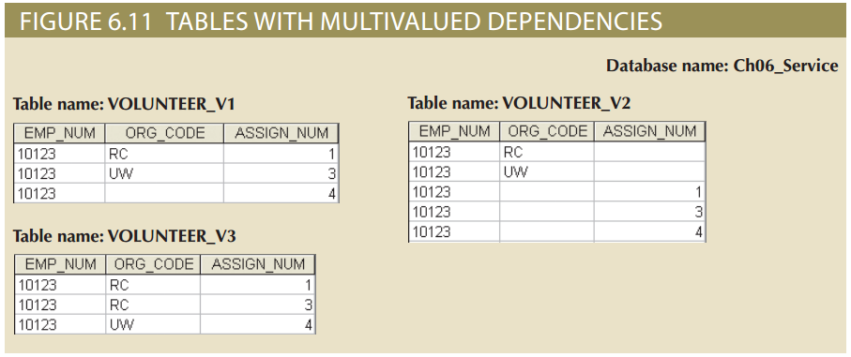
Figure 6.11 - Tables with Multivalued Dependencies

Slide 29
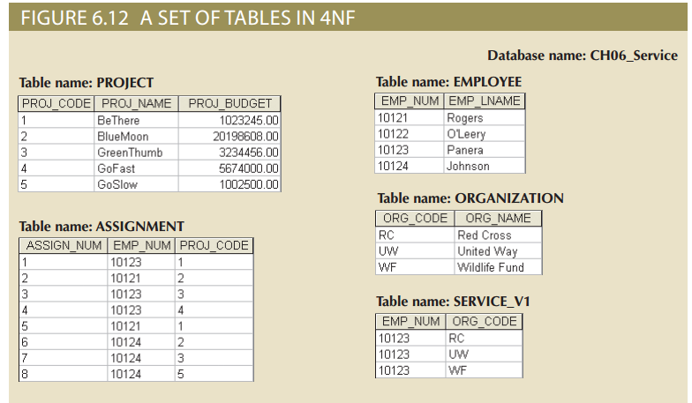
Figure 6.12 - A Set of Tables in 4NF

Slide 30
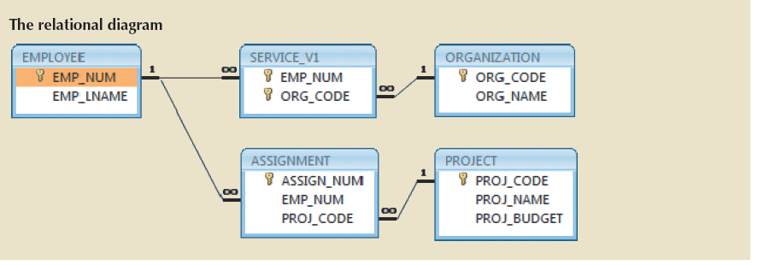
Figure 6.12 - A Set of Tables in 4NF (cont’d.)

Slide 31
Normalization and Database Design
Normalization should be part of the design process
Proposed entities must meet required the normal form before table structures are created
Principles and normalization procedures to be understood to redesign and modify databases
  ERD is created through an iterative process
  Normalization focuses on the characteristics of specific entities

Slide 32
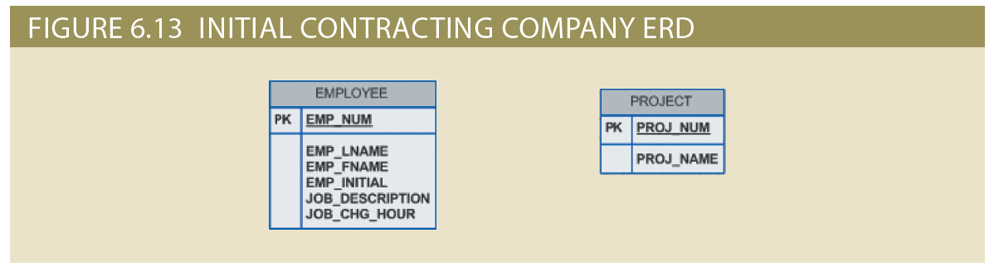
Figure 6.13 - Initial Contracting Company ERD

Slide 33
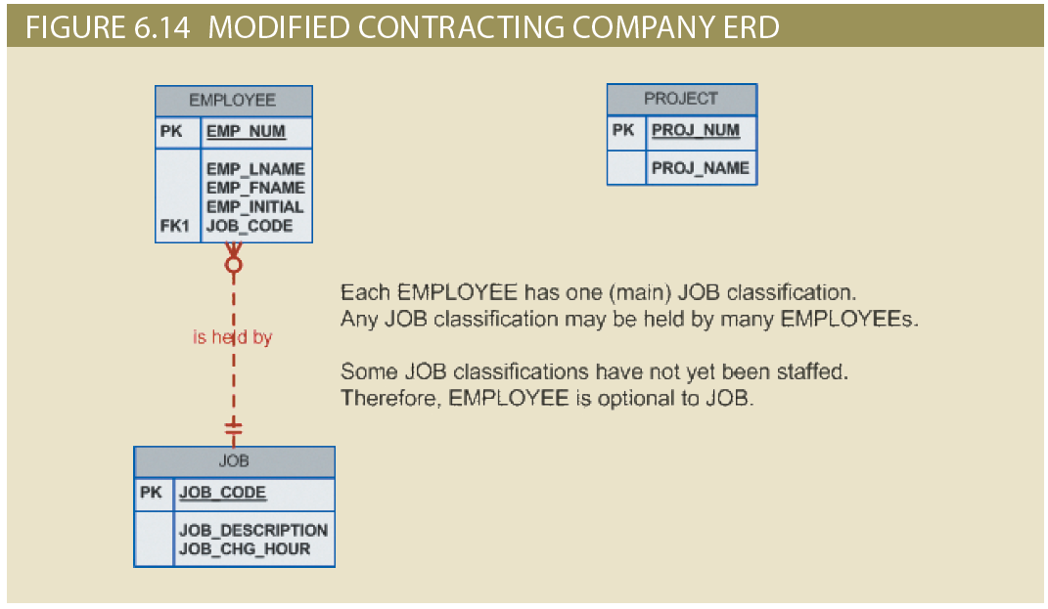
Figure 6.14 - Modified Contracting Company ERD

Slide 34
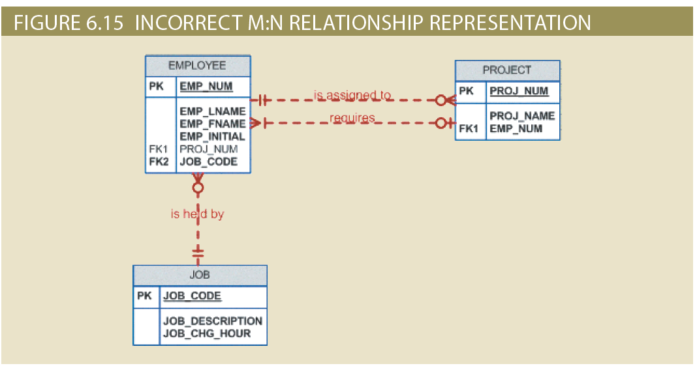
Figure 6.15 - Incorrect M:N Relationship Representation

Slide 35
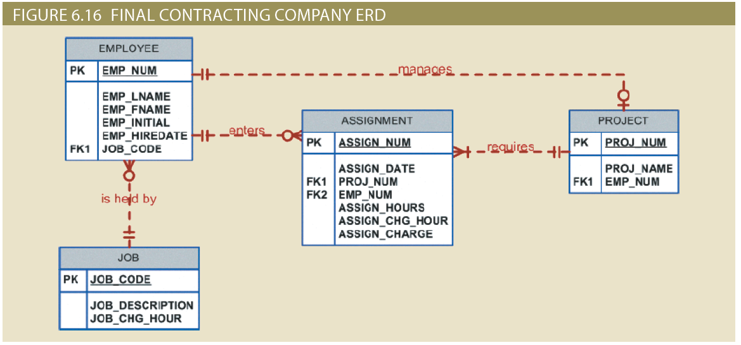
Figure 6.16 - Final Contracting Company ERD

Slide 36
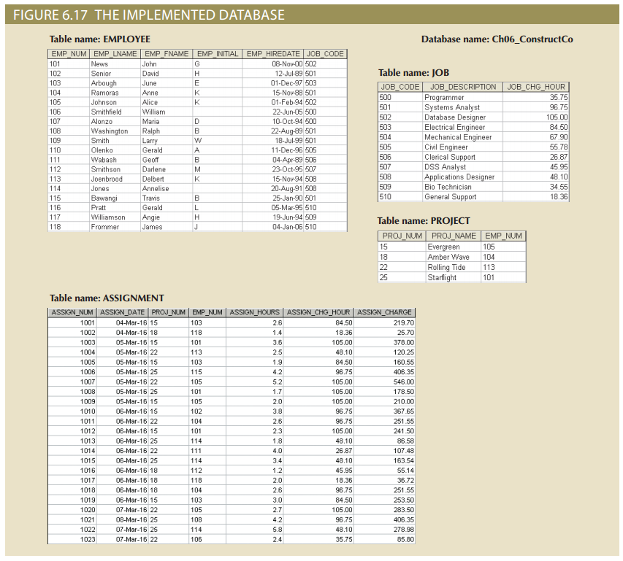
Figure 6.17 - The Implemented Database

Slide 37
Denormalization
Design goals
  Creation of normalized relations
  Processing requirements and speed
Number of database tables expands when tables are decomposed to conform to normalization requirements
Joining a larger number of tables:
  Takes additional input/output (I/O) operations and processing logic
  Reduces system speed

Slide 38
Denormalization
Defects in unnormalized tables
  Data updates are less efficient because tables are larger
  Indexing is more cumbersome
  No simple strategies for creating virtual tables known as views

Slide 39
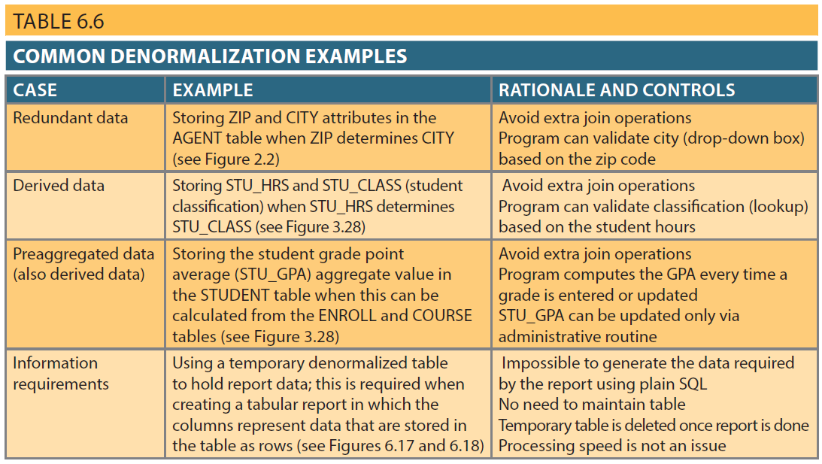
Table 6.6 – Common Denormalization Examples

Slide 40
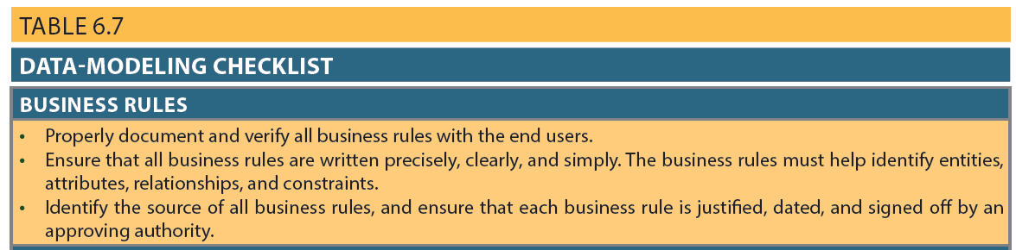
Table 6.7 - Data-Modeling Checklist

Slide 41
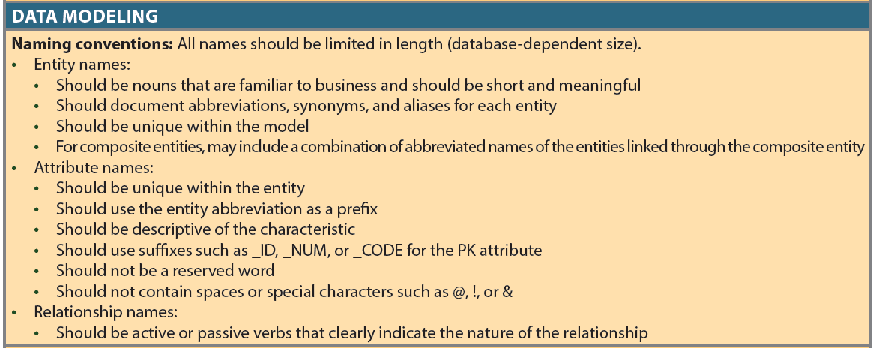
Table 6.7 - Data-Modeling Checklist (cont’d.)

Slide 42
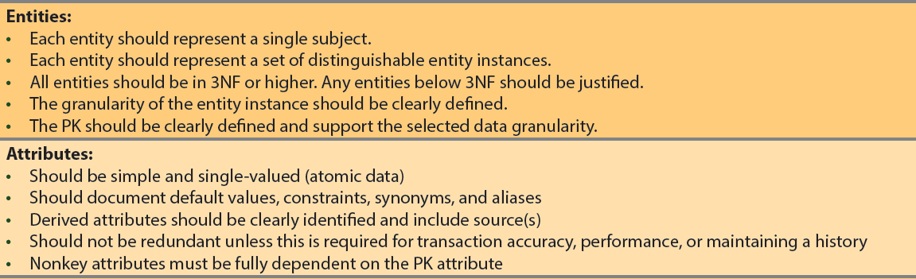
Table 6.7 - Data-Modeling Checklist (cont’d.)

Slide 43
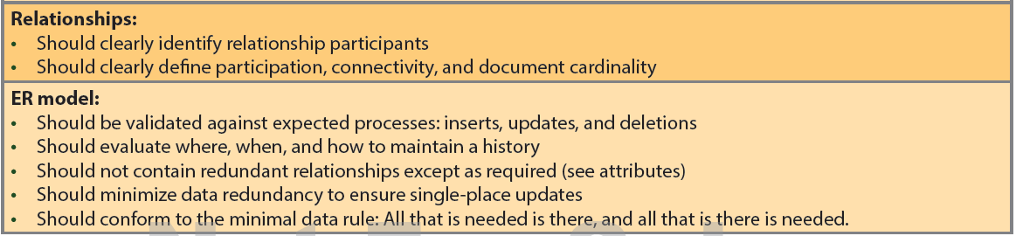
Table 6.7 - Data-Modeling Checklist (cont’d.)

